Slide 1

AUTONOMOUS VEHICLE PROTOTYPE SYSTEM
For ECEN 5763 – Embedded Machine Vision and Intelligent Automation
By Siddhant Jajoo and Sarthak Jain
Under the guidance of Prof. Sam Siewert, University of Colorado Boulde
Platform Used – Jetson Nano

Slide 2
Functional Capabilities
Accurate Detection of objects and targets using OpenCV transforms, Haar cascades and Histogram of Gradients.
Lane detection eliminating multiple lanes using history.
Pedestrian detection using HoG and non-maximum suppression.
Traffic signal and vehicle detection using Haar cascade
Set of services with scheduler, conforming with real-time requirements, to allow for a robust program design.
Processor and memory resources utilized to not exceed hardware capabilities but kept within optimal limits.

Slide 3
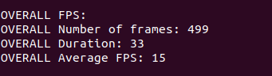
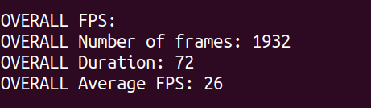
Frame count per second
How high a frame rate did we achieve?
Initial moderate FPS
Final optimal FPS

Slide 4
Frame count per second
How high a frame rate did we achieve?
Frames per second requirements for all threads | Minimum (fps) | Target (fps) | Achieved (fps)
Main thread | 10 | 15 | 27
Pedestrian detection service | 2 | 5 | 9
Lane following service | 6 | 10 | 13
Vehicle detection service | 6 | 10 | 12
Traffic sign service | 2 | 4 | 6
DCT Analysis
Service S_{i} | Requested Frequency (1/T_{i}) (in Hz) | Deadline Frequency (1/D_{i}) (in Hz) | WC frequency (1/C_{i}) (in Hz)
Main thread | 30 | 30 | 30
Pedestrian detection service | 10 | 10 | 10
Lane following service | 15 | 15 | 15
Vehicle detection service | 15 | 15 | 15
Traffic sign service | 7.5 | 7.5 | 8

Slide 5
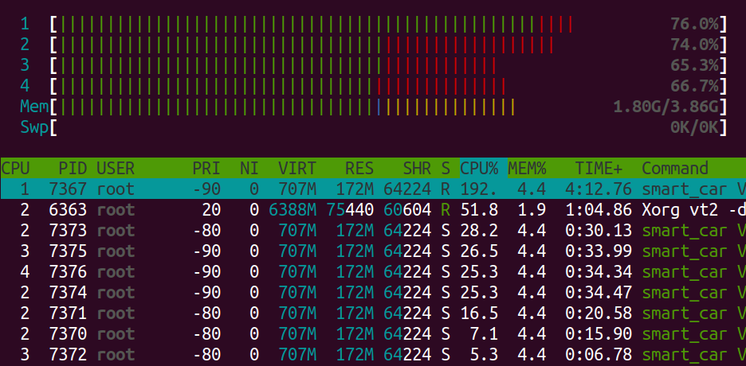
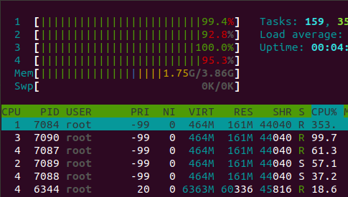
Processor Utilization
How much processor utilization is best?
Moderate CPU usage of 70%
Very high CPU usage of 96%

Slide 6
Scheduler Specifications
Use of 5 semaphores
a. Causing deadlocks due to CFS
FIFO policy set
Services dedicated to cores
a. FPS achieved: 12-15
Scheduler implemented using DCT
Dynamic affinities to allow higher CPU usage
Problem in Linux scheduling (main thread hogging CPU-1)
Thread affinities set for main and other services.
Mutex implementation

Slide 7
Lane Detection
Reduce the resolution by half and get the bottom half.
Create a mask to detect lanes in hsv and hls colour space.
Create ROI mask.
Bitwise and orginal image mask in step 2.
Apply canny threshold to detect lanes.
HoughlinesP to get lane coordinates.
Detect left and right lanes using slopes, averaging coordinates.
Using history to have smooth transitions using average intercept values and average slope values.

Slide 8
Performance Analysis
Factors contributing to high FPS –
Scheduling policy
Minimization of delays in main thread
Individual services’ FPS
Factors contributing to latency
cvWaitKey
Mutex locks

Slide 9
Accuracy Analysis
PR plot of TP/(TP + FP) vs. TP/(TP + FN) for vehicle detection

Slide 10
Accuracy Analysis
Histogram of data for vehicle detection

Slide 11
Accuracy Analysis
PR plot of TP/(TP + FP) vs. TP/(TP + FN) for pedestrian detection

Slide 12
Accuracy Analysis
Histogram of data for pedestrian detection

Slide 13
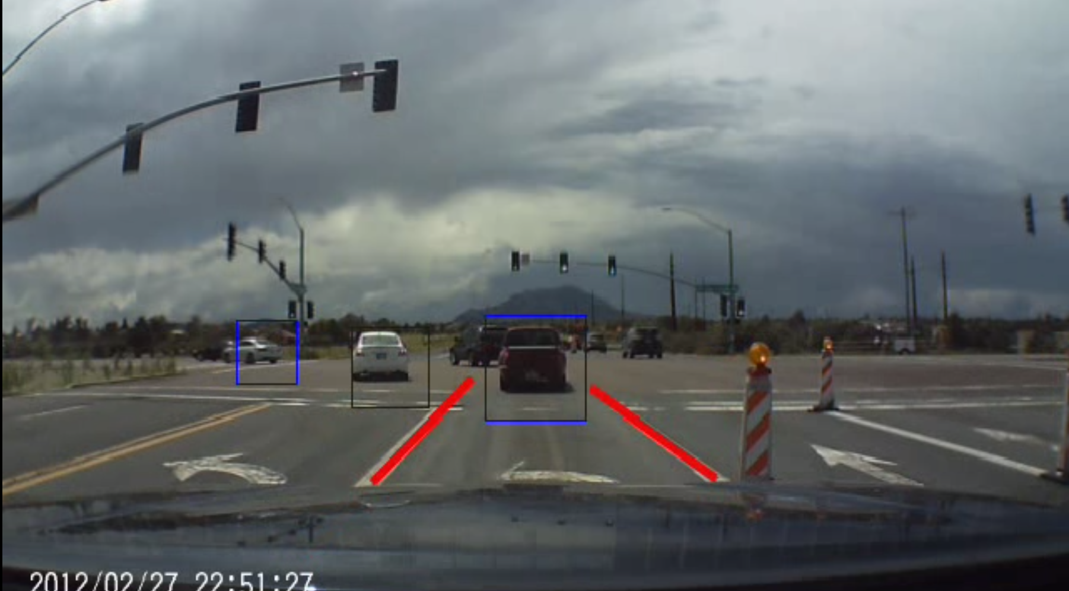
Output cases
Vehicle detection & Lane following

Slide 14
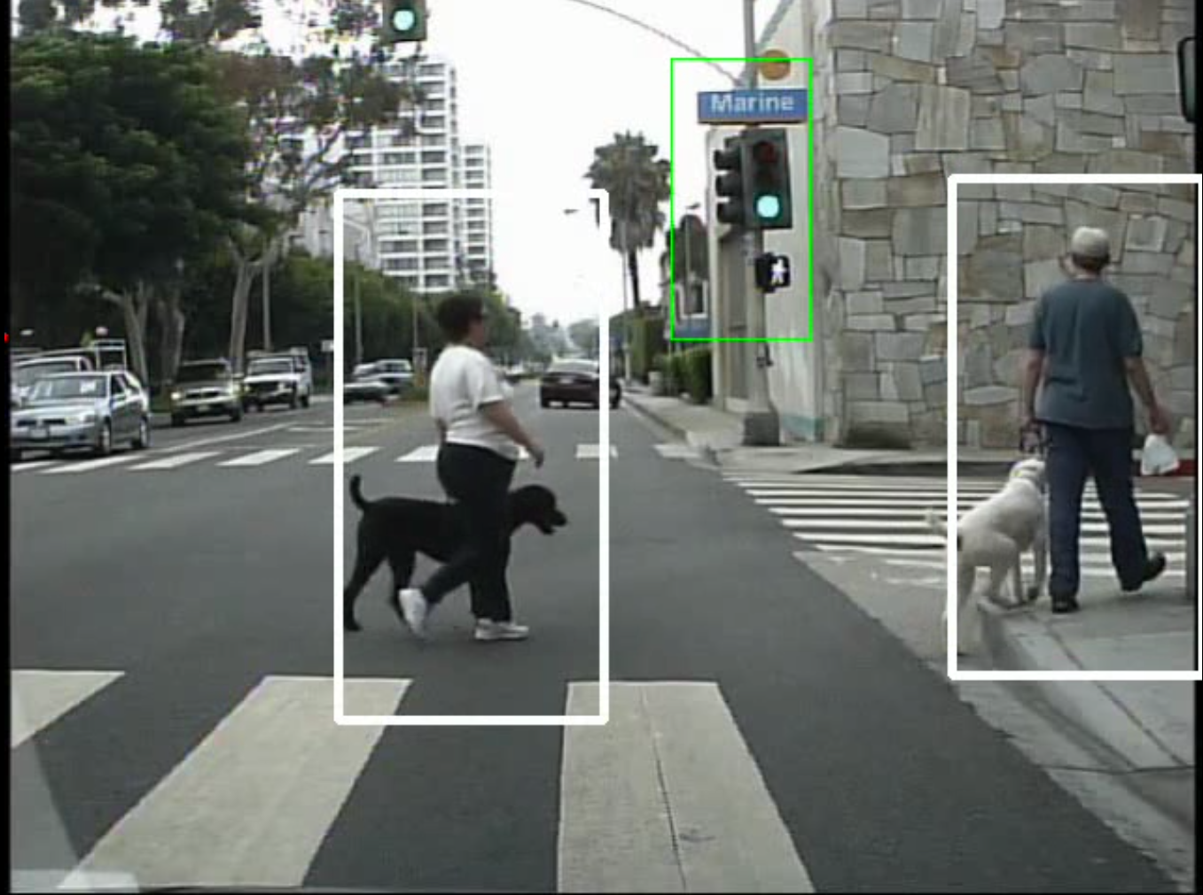
Traffic sign recognition & Pedestrian detection

Slide 15
Conclusion and Future scope
Minimum requirements (achieved):
Detection of each target without misses.
Optimal requirements (achieved)
All above minimum target requirements in multithreaded architecture to make prototype real-time with better FPS.
Notifications to accelerate/decelerate
Targets (future scope)
Integration with Google map APIs for better navigation.
Steering feedback to implement a lane departure warning system.

